Slide 1
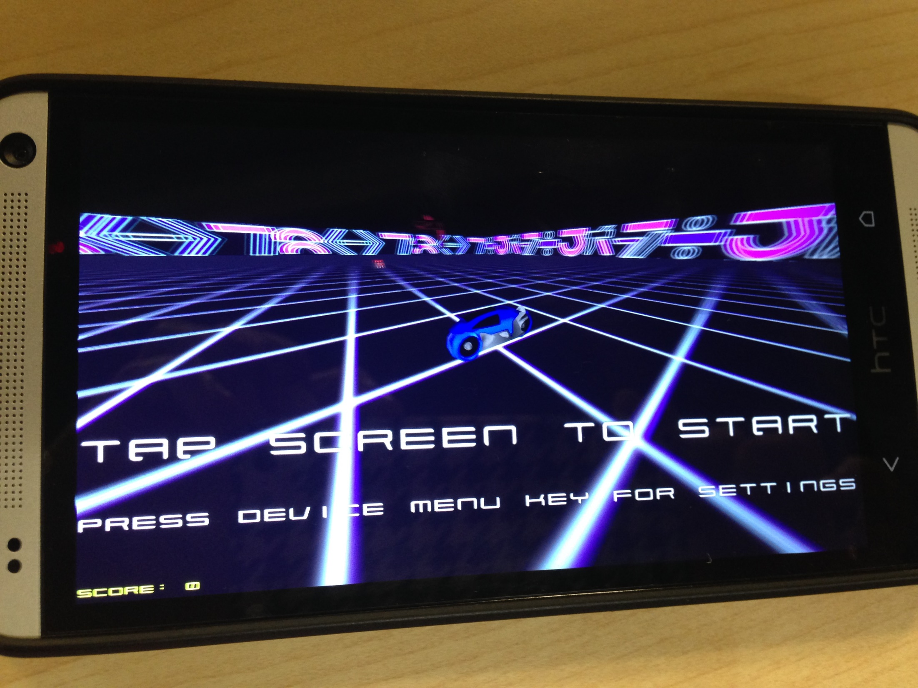
GLTron
By
Sri Vishnu Sirisha Sreekailash Pavan Kumar

Slide 2
Introduction
Gaming is an interesting domain and always growing.
Interactive gaming is slowly gaining popularity with touchscreen, mouse, keyboard, keypad, joystick, et al becoming obsolete.
There is a growing demand for close to reality gaming.
Gaming input ranges from plain hand gestures, sensor gloves, sensor cords, and so on.
We use Texas Instruments sensor tag (TI Sensor Tag) in our game to pass the input signals.

Slide 3
About the Game
GLTron is an enthusiastic game which is about tactical racing. It is a six player game out of which 5 players are operated by the computer.
A player has to ride his bike. The trail leaves a colored marking (wall).
So, a player has to control his bike and keep it from running into others’ walls or obstacles.
One must also not hit a wall created by oneself.
The color of the wall made by each player is different.

Slide 4
About the Game
We can maneuver the bike using sensor tag. The various movements of the sensor tag are as follows:
Left → Left turn
Right → Right turn
Up → Pause
Down → Exit
We can also view the statistics of the game played.
When you click the ‘Show Stats’ button, you get a pie chart of all the movements of the sensor tag.

Slide 5
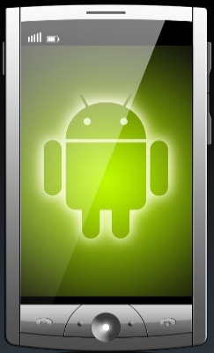

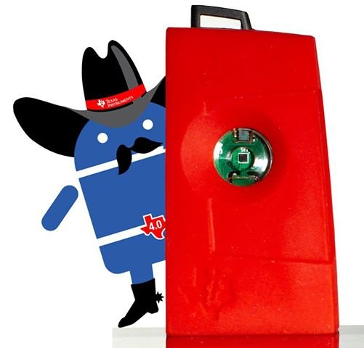

Architecture
Android Phone
Database
Sensor Tag
System Game App

Slide 6
Architecture
“The sensor tag is connected to the system and its movements are captured.”
Android Phone
Database
Sensor Tag
System Game App

Slide 7
Architecture
“The sensor tag data is sent to the game being played in the phone.”
Android Phone
Database
Sensor Tag
System Game App

Slide 8
Architecture
“This data is also stored in the database.”
Android Phone
Database
Sensor Tag
System Game App

Slide 9
Architecture
“The processed data is sent to the app.”
Android Phone
Database
Sensor Tag
System Game App

Slide 10
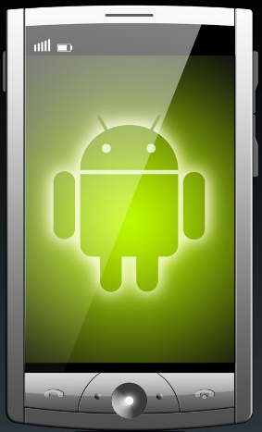
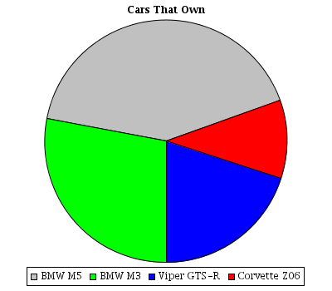
Architecture
“The data is represented in the form of a pie chart in the phone.”
Android Phone
Database
Sensor Tag
System Game App

Slide 11
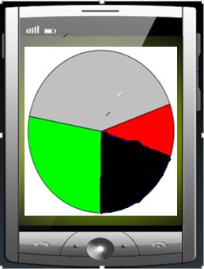
Color Coding for Pie Chart
Red → Left Gesture
Green → Right Gesture
Black → Down (exit)
Grey → Up (pause)

Slide 12
Challenges Faced
We faced the following challenges while designing the game:
As there are many classes in the code, we found it very difficult to back track turnleft() function. It is very difficult to sift through so many classes in the code.
The speed of the bike is very high in the game. There is a lag in the capturing of sensor information while playing the game. So, we reduced the speed of the bike so that the sensor data is captured accurately.

Slide 13
Future Work
There can be a few additions to this game like
Multiplayer gaming facility wherein multiple players can play at once using their mobile phones.
There can be a provision of some additional powers and points to keep the players motivated.
There can be a jump feature to make the game more competitive.
We can also make the game online on facebook so that people can invite their friends to participate in the game.
We can have different arenas to play in.

Slide 14
Analytics
The accuracy of right/left turns can be calculated as follows:
Accuracy = number of recognized right turns
number of actual right turns
The percentage of error in right/left turns can be calculated as follows:
Percentage error = number of actual right turns -
number of recognized right turns X 100
number of actual right turns

Slide 15
DEMO

Slide 16
We thank
Dr. Lee for her support

Slide 17
We thank
And Fiechen Shen for his help

Slide 18
Thank You
Questions???

